Slide 1

Lecture 08: Digital System Design
Dept. of Computer Sc. and Engg.
University of Rajshahi
www.ru.ac.bd
Dr. Mahboob Qaosar

Slide 2
Ripple/Asynchronous Counter
Only the first flip-flop is clocked by an external clock. All subsequent flip-flops are clocked by the output of the preceding flip-flop.
Asynchronous counters are slower than synchronous counters because of the delay in the transmission of the pulses from flip-flop to flip-flop.

Slide 3
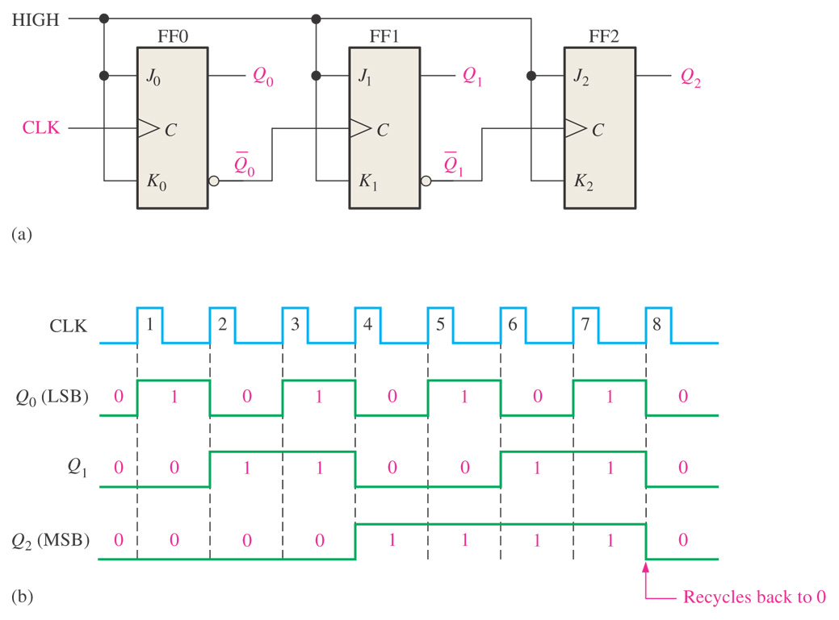
3-bit asynchronous binary counter and its timing diagram for one cycle.

Slide 4
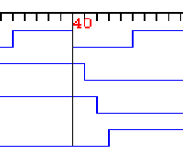
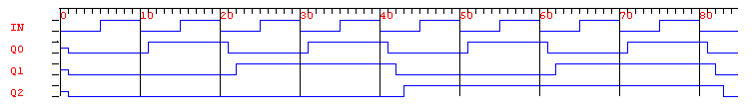
The Ripple Effect…
Q0
Q1
Q2

Slide 5
Ripple Effect…The Problem
Q0
Q1
Q2
3
4
2
0

Slide 6
Synchronous Counters
All flip-flops are clocked simultaneously by an external clock.
Synchronous counters are faster than asynchronous counters because of the simultaneous clocking.
Synchronous counters are an example of state machine design because they have a set of states and a set of transition rules for moving between those states after each clocked event.

Slide 7
Difference between Asynchronous and Synchronous Counter
Asynchronous Counter | Synchronous Counter
Clock input is applied to LSB FF. The output of first FF is connected as clock to next FF. | Clock input is common to all FF.
All Flip-Flops are toggle FF. | Any FF can be used.
Speed depends on no. of FF used for n bit . | Speed is independent of no. of FF used.
No extra Logic Gates are required. Cost is less. | Logic Gates are required based on design. Cost is more.

Slide 8
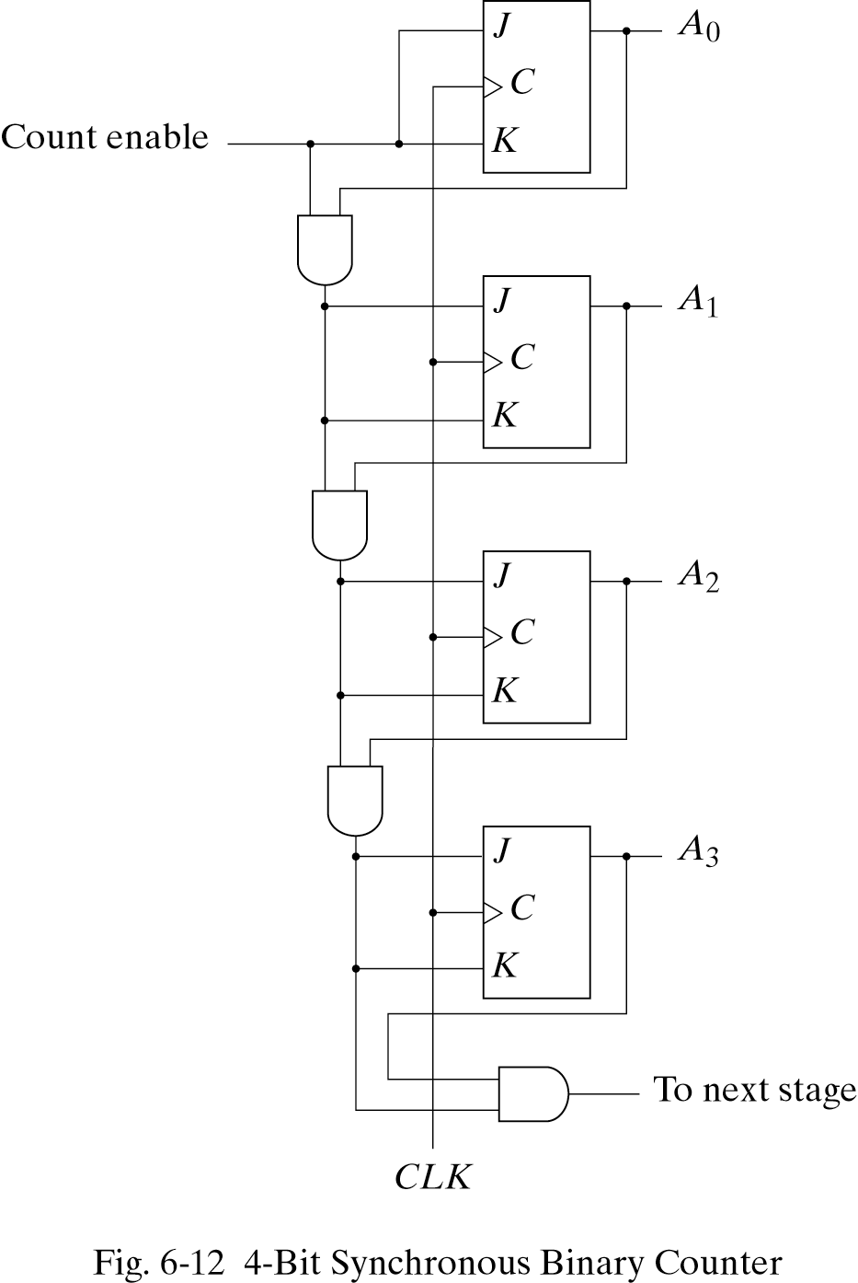

Slide 9
Design Procedure for Synchronous Counter
The clock input is common to all Flip-Flops.
Any Flip-Flop can be used.
For mod-n counter 0 to n-1 are counter states.
The excitation table is written considering the present state and next state of counter.
The flip-flop inputs are obtained from characteristic equation.
By using flip-flops and logic gate the implementation of synchronous counter is obtained.

Slide 10
JK flip-flop inputs
If we use JK flip-flops instead, then we have to compute the JK inputs for each flip-flop.
Look at the present and desired next state, and use the excitation table on the right.
Q(t) | Q(t+1) | J | K
0 | 0 | 0 | -
0 | 1 | 1 | -
1 | 0 | - | 1
1 | 1 | - | 0

Slide 11
Design of Mod-6 Synchronous counter
The count sequence for Mod-6 counter is as follows:
000,010,011,110,101,001
Excitation table is formed for given count sequence.
Flip-flop inputs are derived from present state and next state.
From K –map simplification the Flip-flop input equations are obtained.
Logic diagram of Mod-6 counter is drawn by using JK-FF and logic gates.

Slide 12
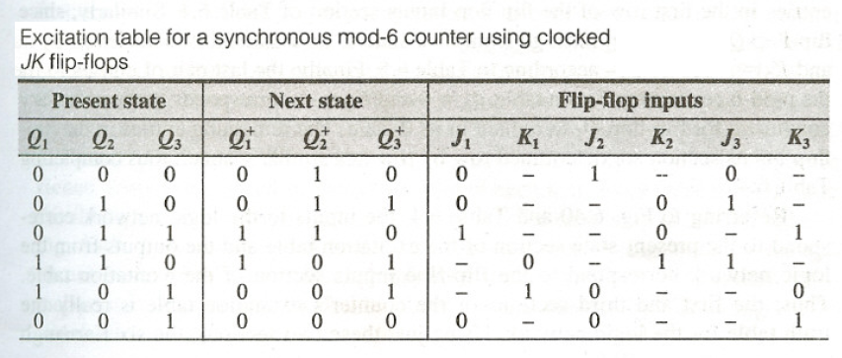
Q(t) | Q(t+1) | J | K
0 | 0 | 0 | -
0 | 1 | 1 | -
1 | 0 | - | 1
1 | 1 | - | 0

Slide 13
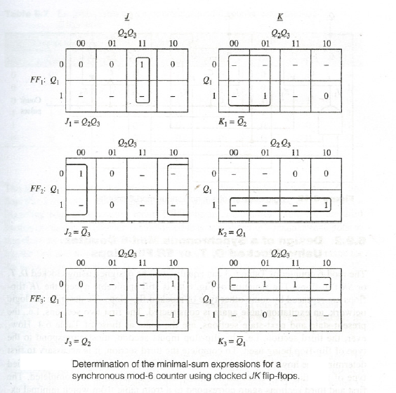

Slide 14
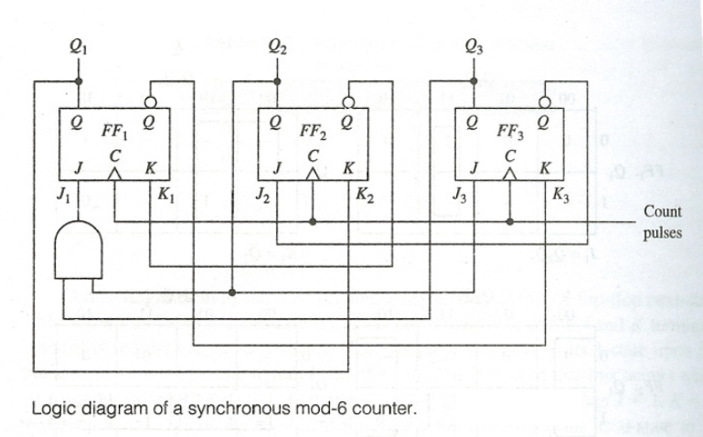

Slide 15
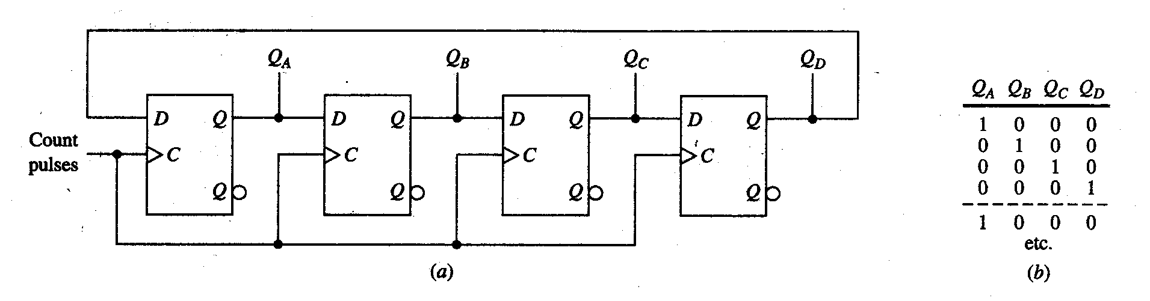
Counters Based on Shift Register
The output of LSB FF is connected as D input to MSB FF.
This is commonly called as Ring Counter or Circular Counter.
The data is shifted to right with each clock pulse.
This counter has four different states.
This can be extended to any no. of bits.

Slide 16
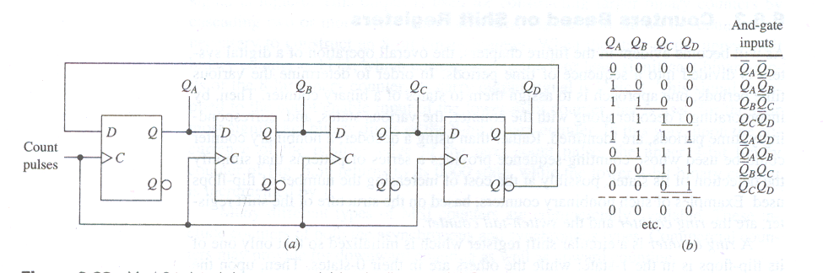
Twisted Ring Counter or Johnson Counter
Mod-8 Johnson Counter
The complement output of LSB FF is connected as D input to MSB FF.
This is commonly called as Johnson Counter.
The data is shifted to right with each clock pulse.
This counter has eight different states.
This can be extended to any no. of bits.

Slide 17
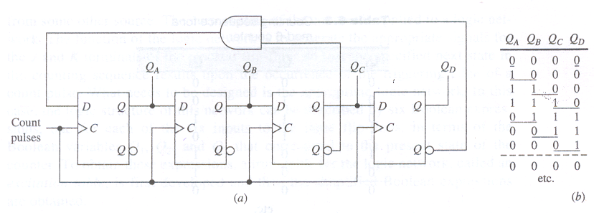
Mod-7 Twisted Ring Counter
The D input to MSB FF is
The counter follows seven different states with application of clock input.
By changing feedback different counters can be obtained.

Slide 18
End

